Slide 1
BRUKS 1006 Chipper

Slide 2
1006 Chipper Unit
Weight 8500 kg

Slide 3
Chipper housing
Robust design,
25 mm steel in the sides
Exchangeable wear parts in Hardox steel

Slide 4
Heavy duty anvil in known design
Anvil in fixed position
Shear bolts

Slide 5
Drum, 1000 x 1200
Rotating
speed 750 rpm
Four full-lenght knife holder seats
Weight
1850 kg
+750 kg
2600 kg
Strong bearing

Slide 6
Knife options
Normal setting for fuel chips,
40 – 45 mm chip-lenght
Settings for micro chips,
10 mm chip-lenght
X 4
X 4

Slide 8
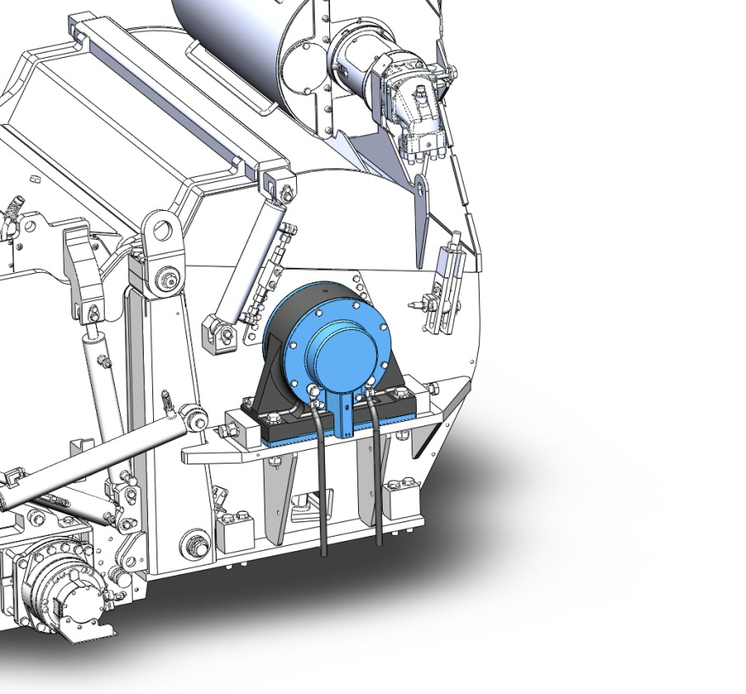
Chipper housing with drum

Slide 9
Upper feed roller
Powerful 800 mm upper roller
Built in hydraulic motor.

Slide 10
Upper feed roller

Slide 11
Infeed table

Slide 12
Infeed table
Service position
Parking position

Slide 13
Accelerator hood

Slide 14
New turning equipment
Slewing ring with ball bearings
Worm screw with hydraulic motor. Self-locking

Slide 15
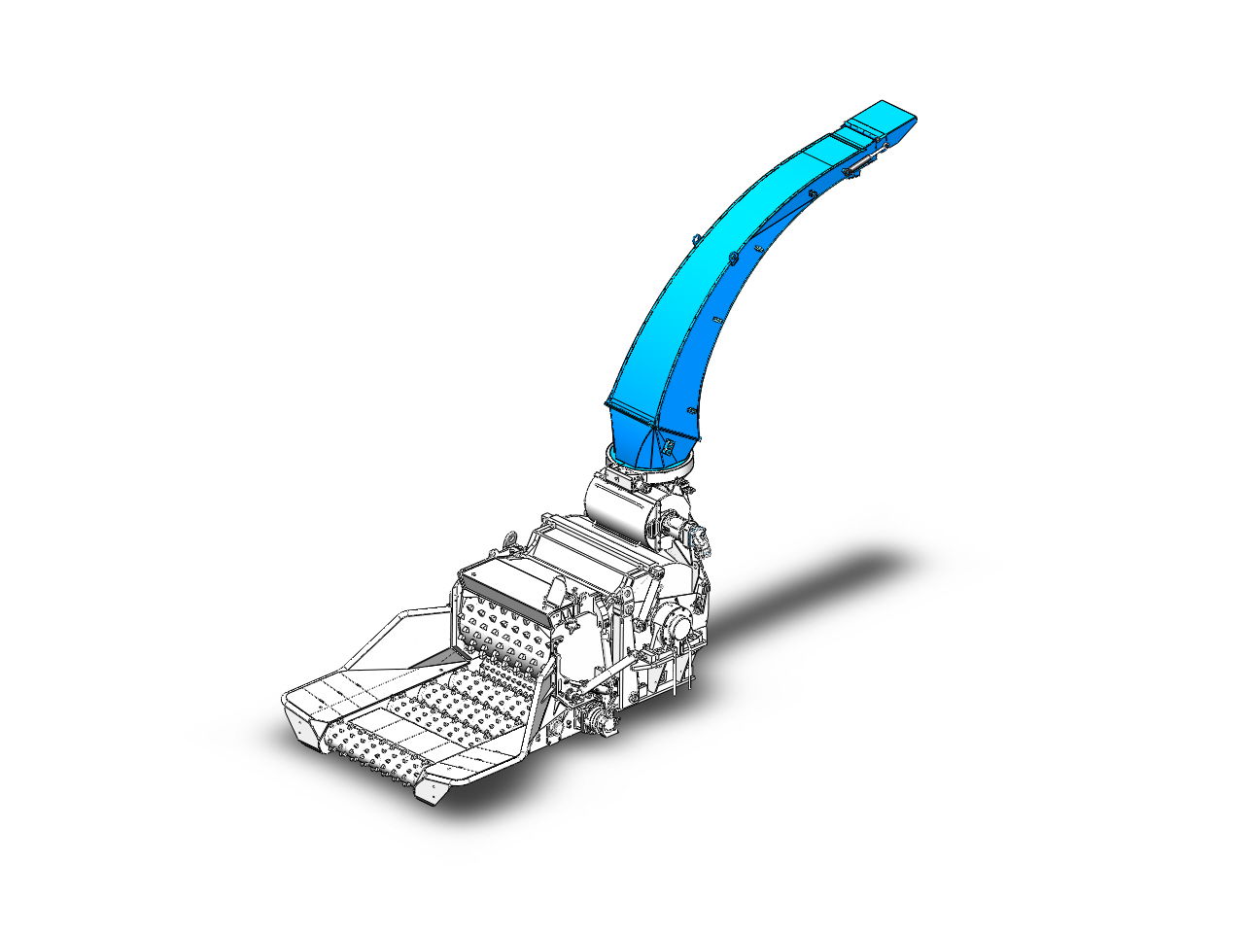
Chip tube

Slide 16
Chip Tube in new design
Standard in raised position
Parking position

Slide 17
Chip tube with extension, 1160 mm
Raised position
Parking position

